Slide 1
How to Distribute
Digital Christian Resources Overseas

Slide 2
Why?
70%+ of pastors have no formal training
Your resources could help them a lot
The resources need to be free of charge
They need to easy to access
They need to be appropriate

Slide 3
Hello, I'm Racheal I really take this opportunity to thank you for the prayer courses you have always sent me. At first I was depressed and I felt God was far from me however, on reading the prayer courses from #1 to #23 I realised that I needed to focus on God more and guess what....the Lord is doing wonders in my life. I used not to smile but now I smile a lot and colleagues wonder what's happening in my life, last month I was rewarded as the best employee in my company, I have started sharing the good news freely, and I have realised that in my simple prayers I make God answers. The prayer course line is helping me so much. This foundation you started building in me is not a waste. I'm blessed to have joined. God bless you.

Slide 5
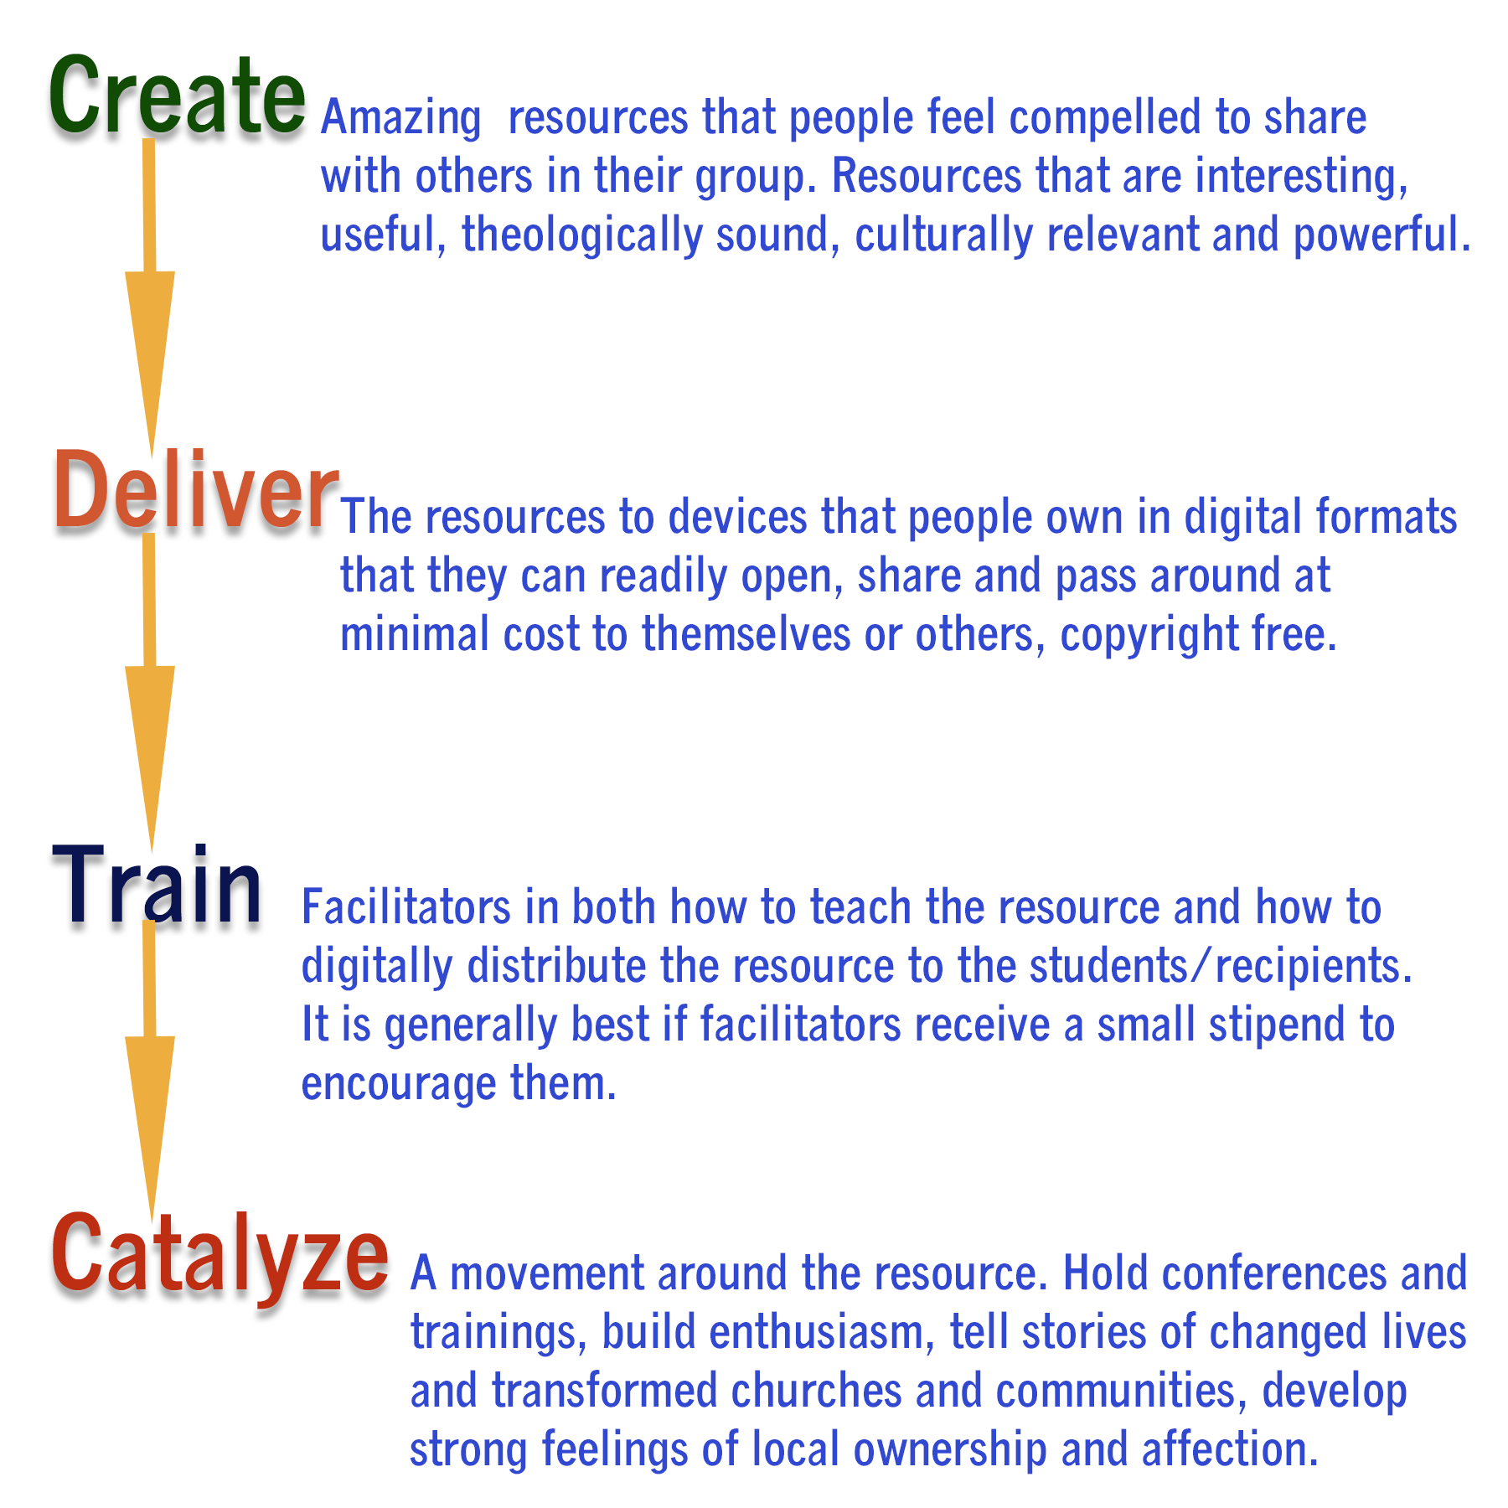

Slide 6
Designing Content For Overseas
Low cost
Low bandwidth
Free to distribute (Creative Commons)
Not too Western, not political
Theory + How-To (Step-by-Step)
Bible-based as main authority

Slide 7
Content Formats
Should be a format that they know how to download and open on their mobile phones, tablets and computers
HTML, doc/x, PPT/x, txt, PDF, epub, mobi (Kindle), Audio: MP3, FLAC Video: MP4, AVI,3GP, WMV
Do not use weird formats that require a specific piece of software such as .pub (Microsoft Publisher)

Slide 8
Ebooks
Back in the 1990’s everyone was on dial-up and bandwidth and time online mattered. People did not want to download 25 of my articles one-by-one, however I could put them all in an ebook, size 250KB, and they could download it in a minute or so.
This scenario has returned with mobile data in the developing world

Slide 9
Uses For Ebooks
Church membership / services guide
Bible studies & Bible teaching
Sermon collections
Free textbooks for overseas
Testimonies, Devotionals, Christian Poetry

Slide 10
MP3
MP3 downloads
Internet Radio
Podcasts
Audio Books
Lower bandwidth than video, more private, & easier to edit

Slide 11
Video
For higher bandwidth areas
Host on YouTube, Vimeo or Facebook.
Brief videos can be shared by BlueTooth

Slide 12
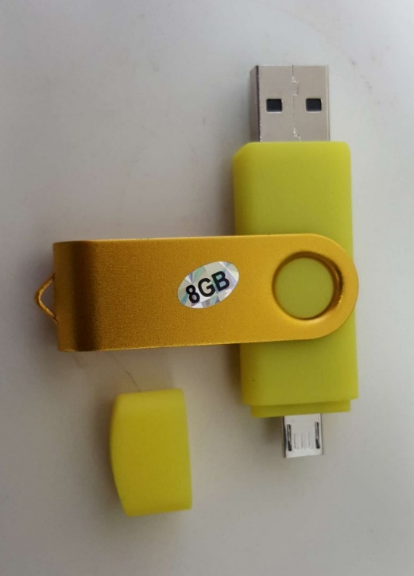
Delivery Mechanisms
SD cards
USB (thumb drives)
Hard drives
BlueTooth
CDs and DVDs
SMS / Messaging (as an attachment)

Slide 13
Websites and Blogs
Have a website or blog with the materials you want to share and have it well-organized by topic and language so materials are easy to locate.
Also have a “Search” box
Publicize it among the people you want to reach
Do search engine optimization

Slide 14
DropBox Sharing
In higher bandwidth areas with affordable mobile Internet
Give people a log-in, and share files, Ok for limited audiences.
Dropbox, OneDrive, Google Drive, Spider Oak, Box

Slide 15
Sending Very Large Files
MediaFire
SendAnyWhere
Google Drive
WeTransfer
Resilio Sync (formerly BitTorrent Sync)
Use 7-Zip to compress files

Slide 16
SFTP In The Cloud
SFTP = Secure File Transfer Protocol
DriveHQ.com account you get 1GB free and that can hold a lot of text or audio files.
Give people the log-on and they can download say using FileZilla

Slide 17
Pastorbox
A rugged wireless hotspot that shares training materials in remote locations.

Slide 18
Email
Venerable but useful, can be passed along
Attachments < 5MB
Email groups
Lists
Autoresponders
HTML vs. Plain Text

Slide 19
Email Autoresponders
I use Olam email autorepsonder (free) to send out daily devotionals, email courses and ebooks to those who sign up
Over 5000 receive ebooks this way
Over 4500 do a prayer course!

Slide 20
Social Media
Secret Social Media Groups
Attachments to WhatsApp messages
Use Social Media to publicize the download URL and publicize the benefits
Create networks of influence.

Slide 21
Others
Small brochures and tracts that can be easily photocopied / printed and handed out.
Book distribution & Print On Demand
Christian radio stations
Satellite TV, Christian TV

Slide 22
Helping People Find Your Material
Research Where They Go To Find Things
Have Good Titles and Descriptions
Search Engine Optimization
Distribute Through Large Church & Mission Networks
Tagging and Meta-Tagging e.g for MP3 files
Social Media, E-Groups, Forums, Reddit etc

Slide 23
Word Of Mouth
Quality Drives Quantity
Make It Easy To Share & Pass Around
Does It Meet A Felt Need?
Does It Feel Useful?
Does It Create Buzz?

Slide 24
Security
No distribution method is 100% secure
Main concern of “enemies” is political material
Servers in Germany, Norway etc. are more secure
Device-to-Device is best (not via Internet)
Using a VPN means you are less likely to be throttled when sending large files to others.
Encrypted files and hidden partitions may help
VeraCrypt can create hidden partitions

Slide 25
Secure Messaging
Signal
Threema
Telegram
WhatsApp
Pidgin with Paranoia plug-in
Viber
Messenger

Slide 26
John Edmiston
www.Cybermissions.org
johned@Cybermissions.org
Twitter: @Cybermissions

