Slide 1
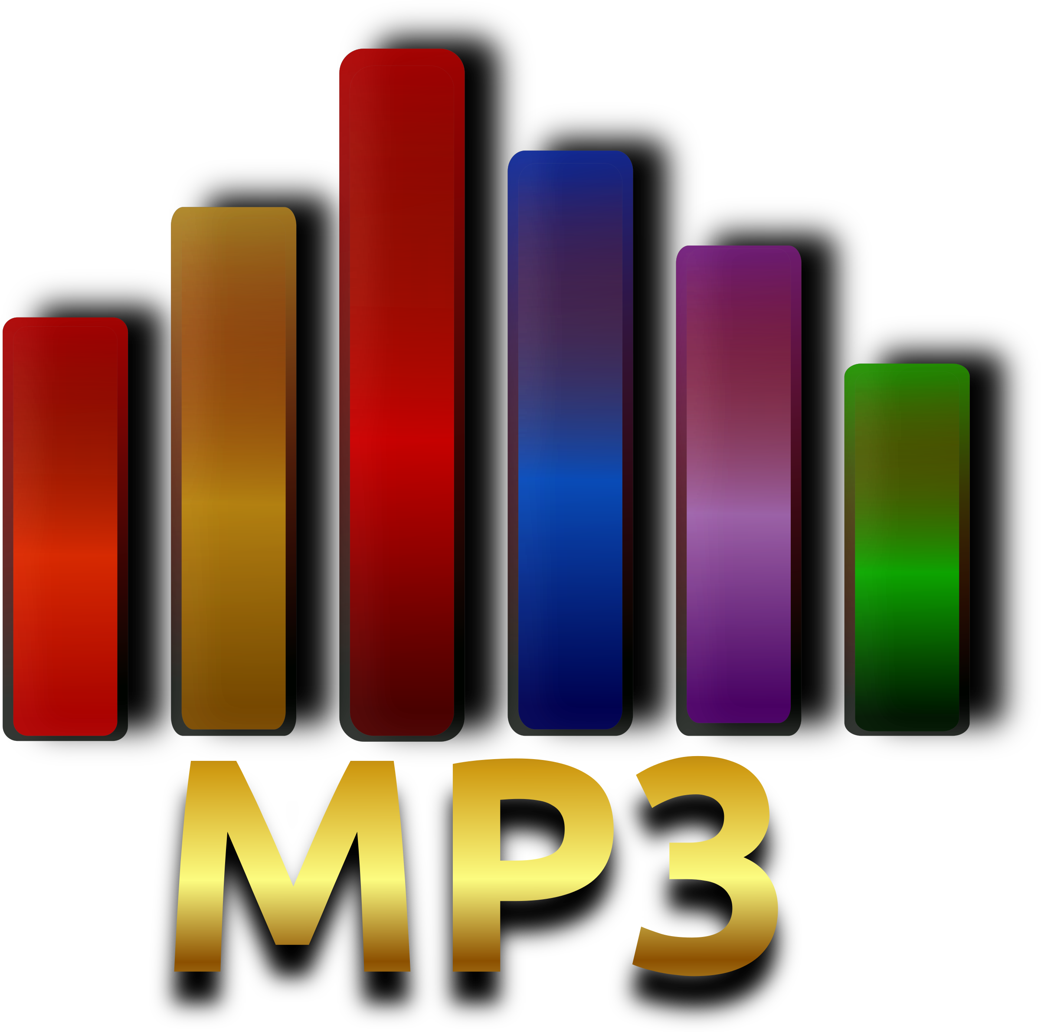
MP3 Files
In mission and ministry

Slide 2
Why mp3 files?
MP3 files work on nearly all computers, phones, tablets, etc
They can be listened to while working on other things or while stuck in traffic
People are familiar with them, and with downloading them
They are more private than video, if headphones are used
Suitable for oral learners / non-readers / storying cultures
Use much less bandwidth / storage than video
Far easier to edit than video
Contain the same information as video for sermons etc

Slide 3
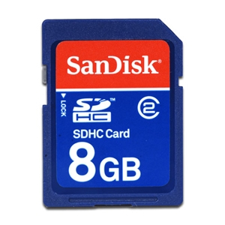
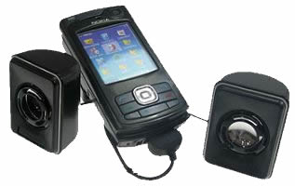
The Mobile Bible College
Curriculum on an SDHC card
A mobile phone + speakers
Does not need reliable electricity
Does not require Internet access
Portable, secure and looks normal
Can train up to 25 people
Useful for house churches
Works with most types of phones
SDHC cards: 8Gb will hold up to 500+ hours of reasonable quality audio
30 hrs lecturing = one bible college subject (with some class discussion of the material)
So therefore 500 hrs = 16 subjects = 4 semesters of 4 subjects = 2 year course on a fingernail-sized chip

Slide 4
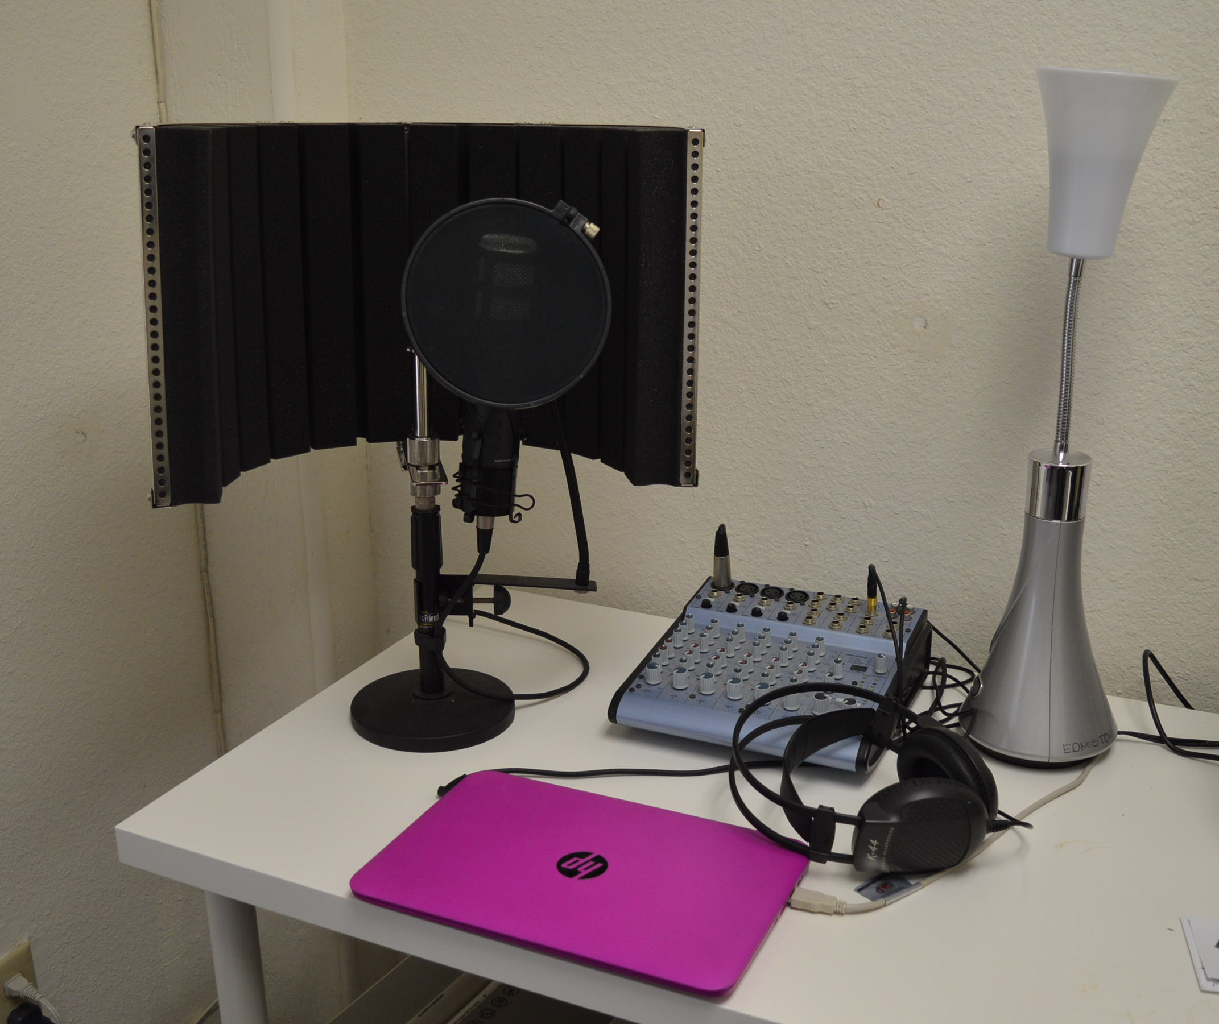
The basic setup
All audio gear is from MusiciansFriend.Com

Slide 5
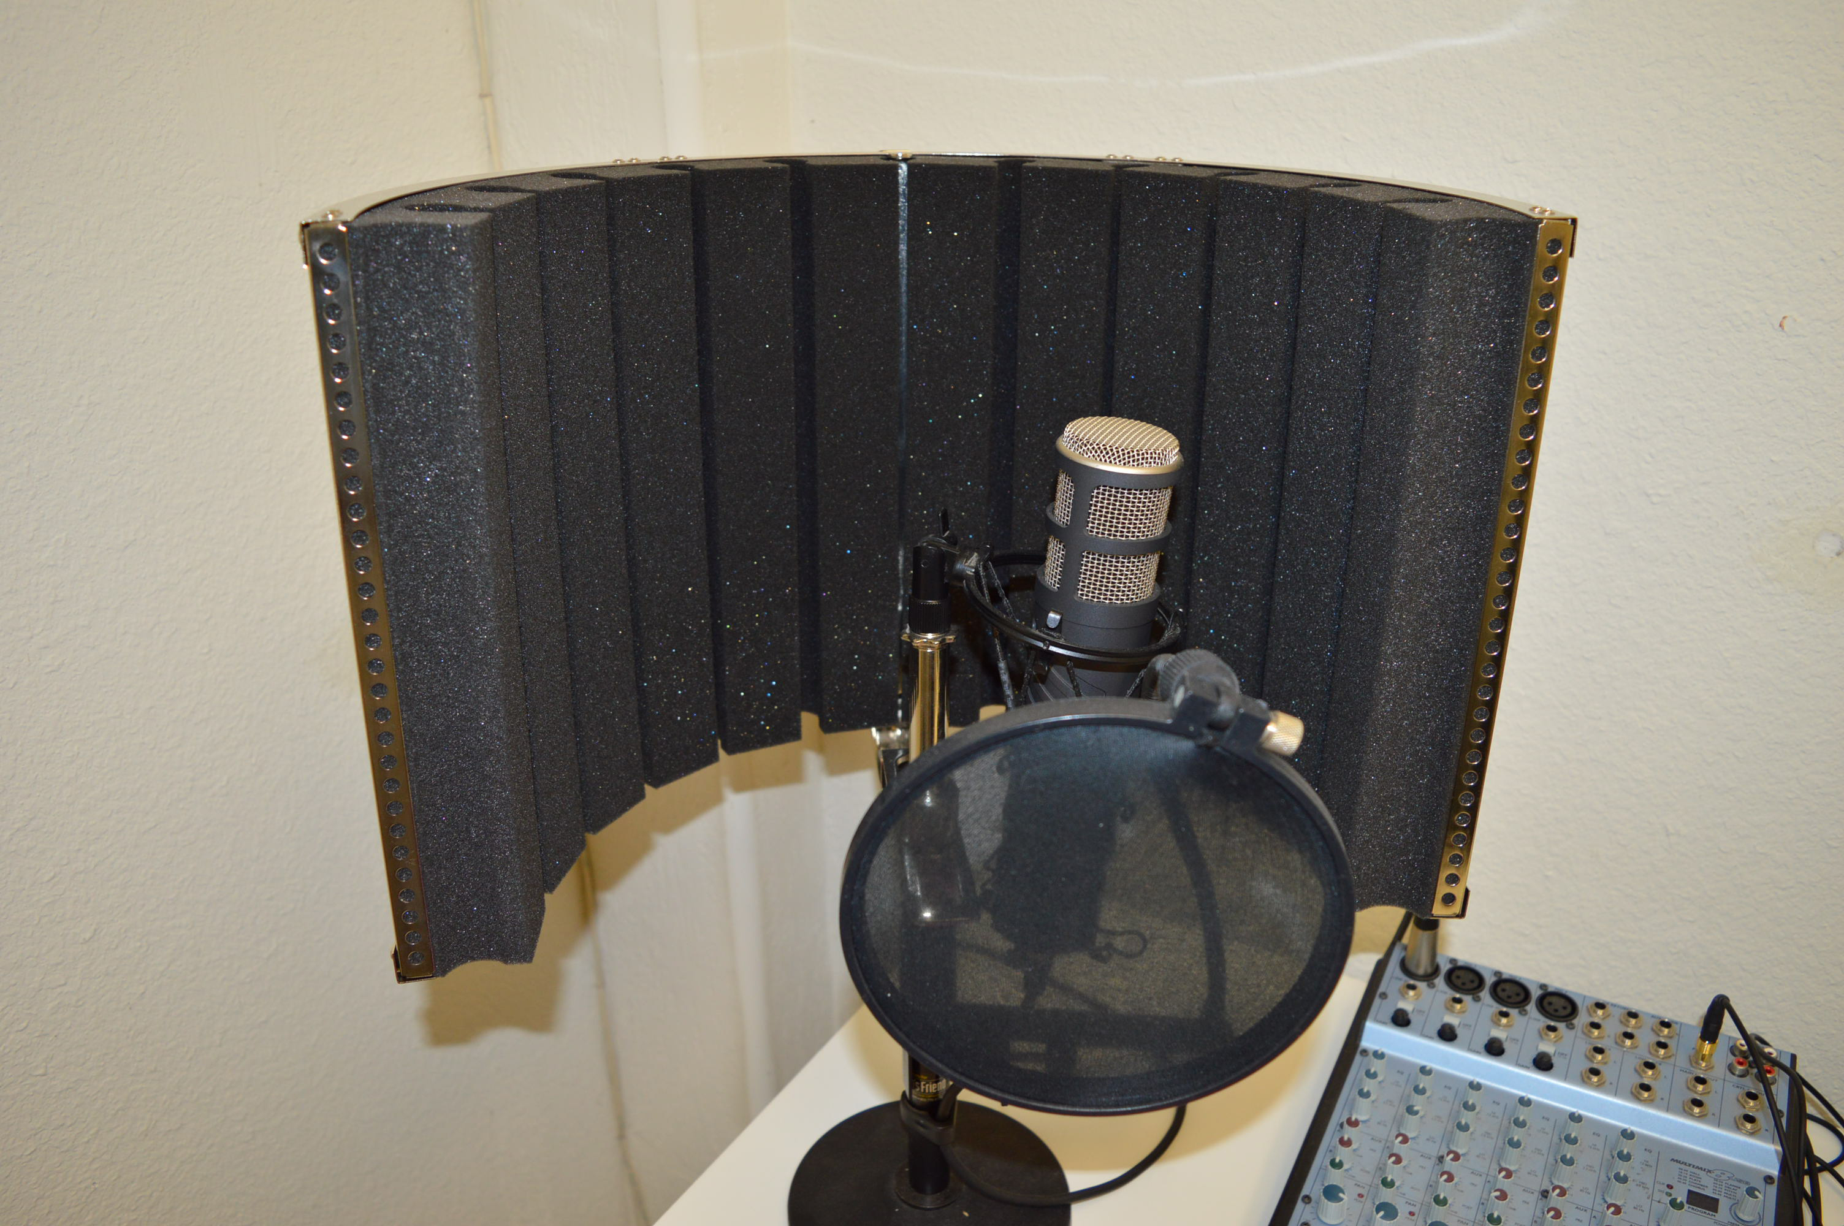
microphone
A good quality microphone (Rode Procaster - $300)
A pop filter
A curved 180 degree sound reduction baffle to reduce ambient noise reaching the microphone.

Slide 6
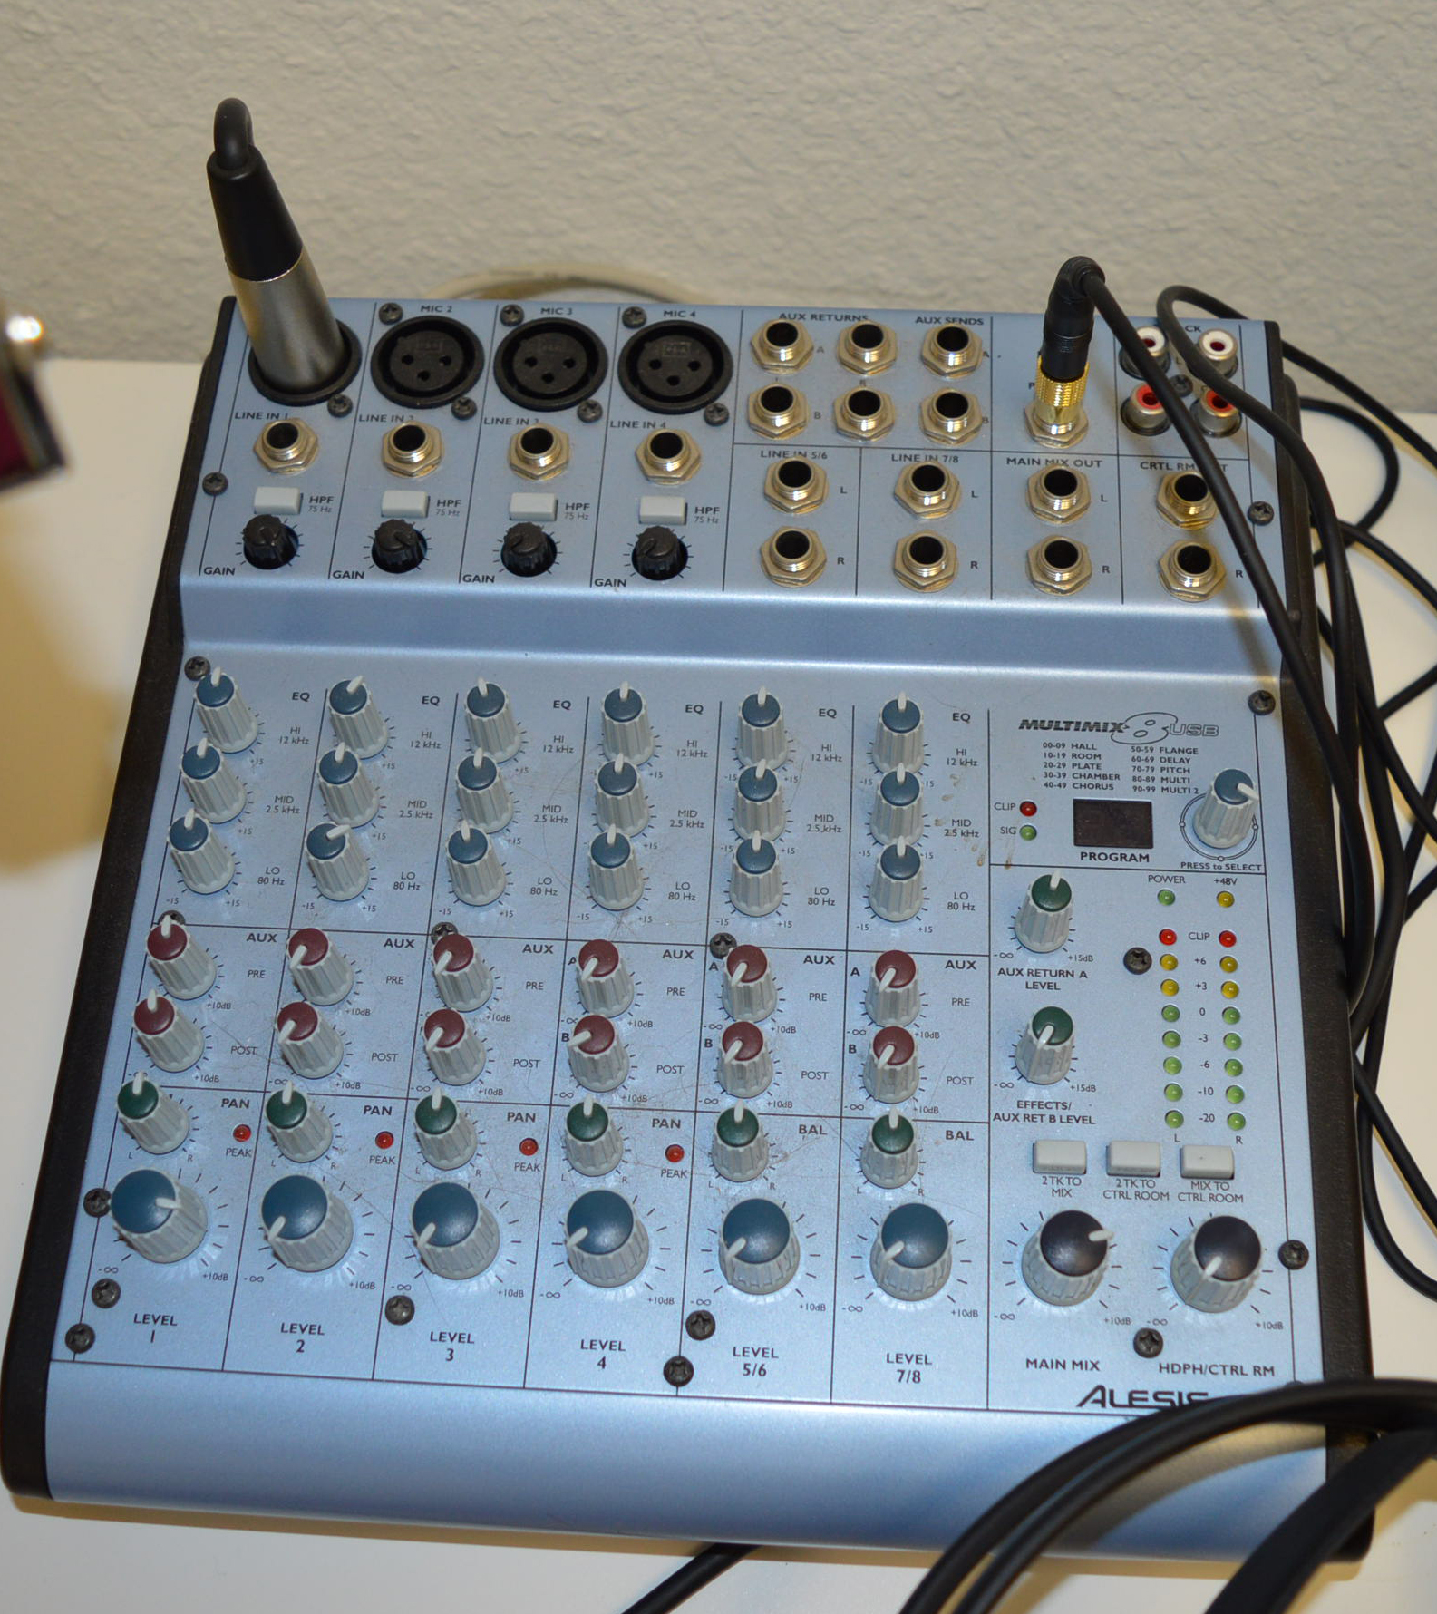
A basic 8-channel mixer
Is sufficient for training audio & podcasting

Slide 7
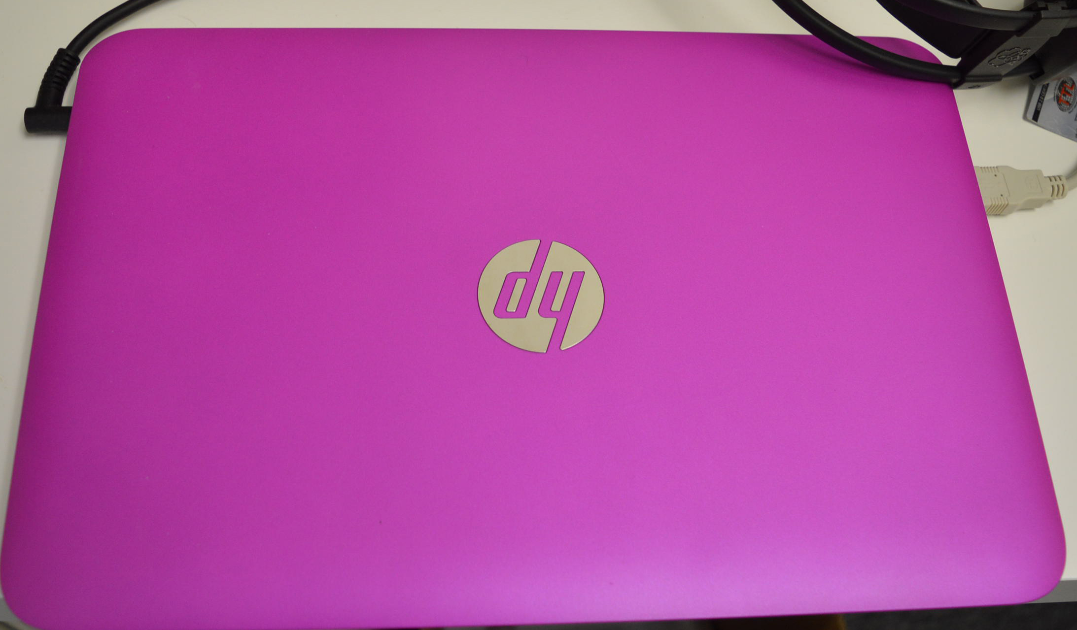
Hp stream 13”
$199, has an SSD which makes no noise at all
And it is quite good enough for basic audio editing

Slide 8
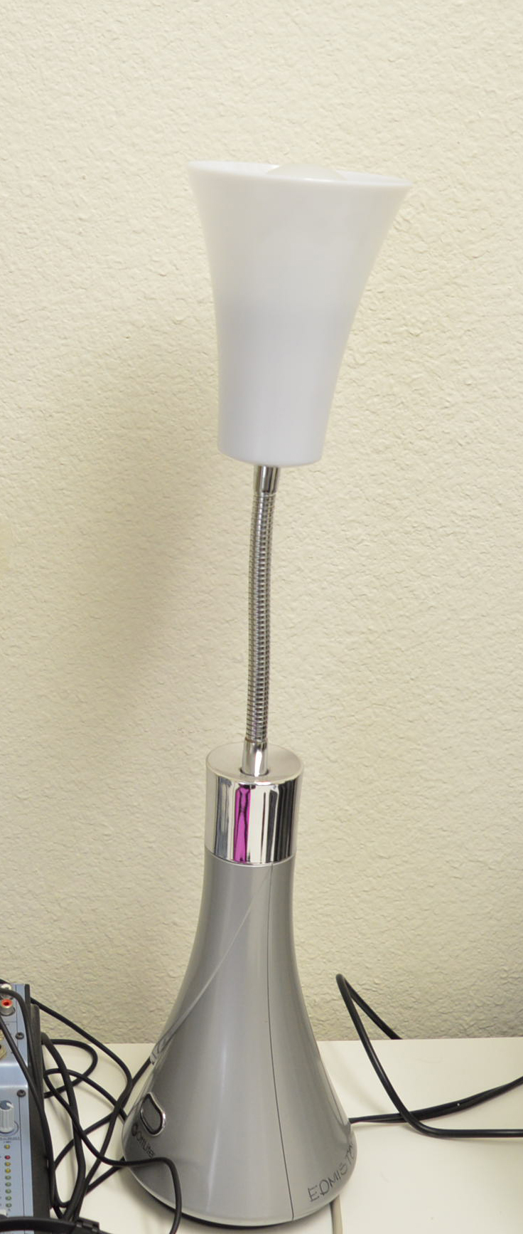
Noise free lamp
Reduces fluorescent hum noise in the office

Slide 9
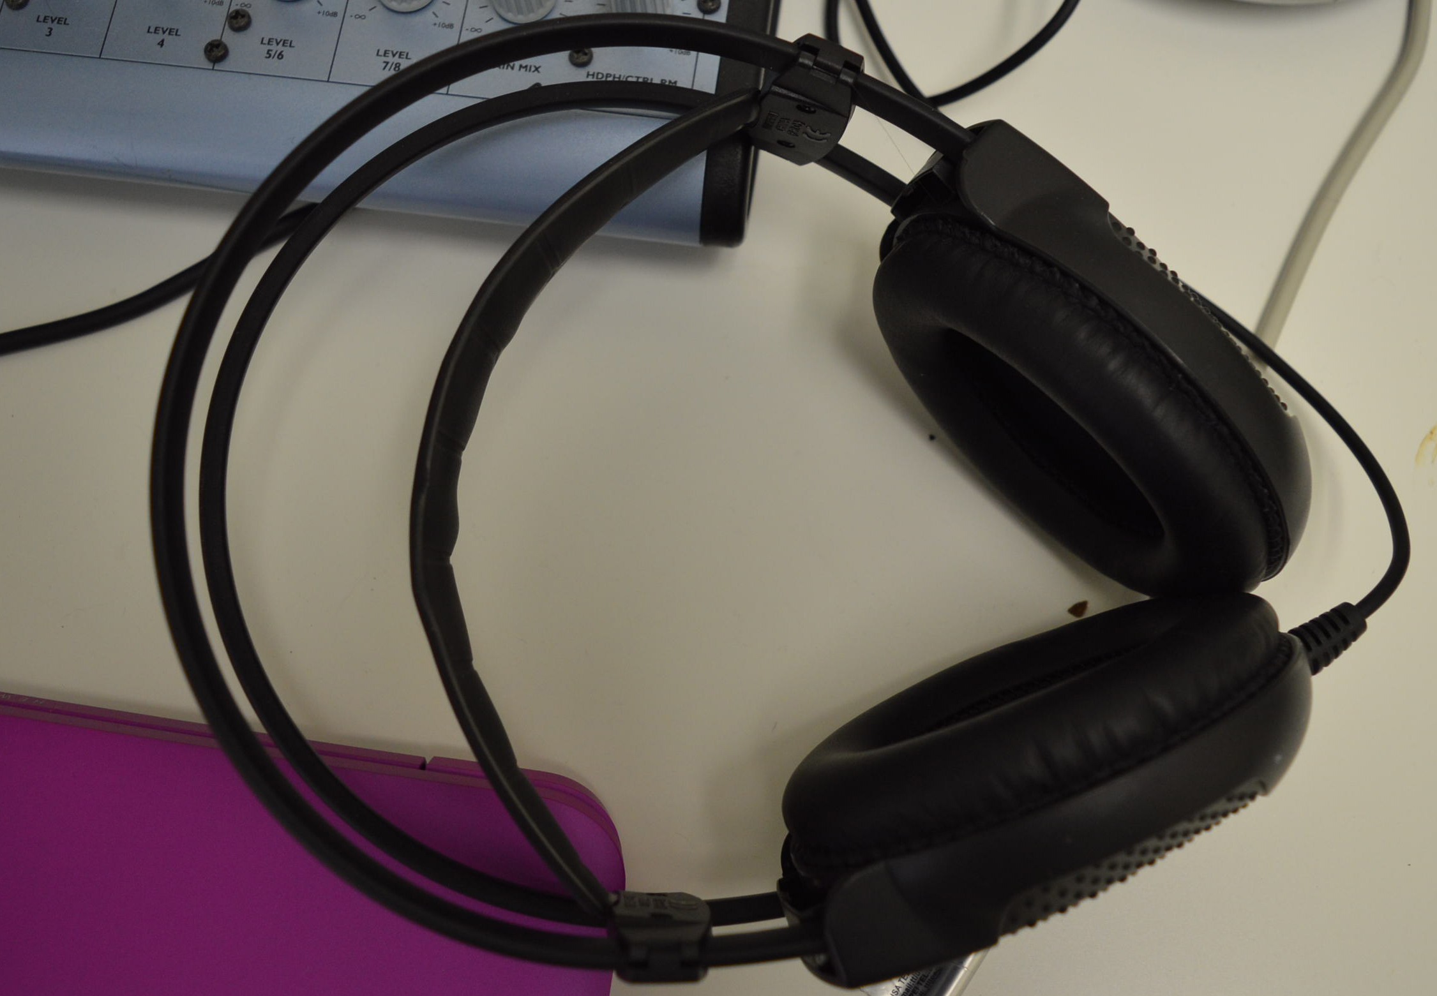
Decent headphones
For checking audio quality
during recording and playback

Slide 10
audacity
https://sourceforge.net/projects/audacity/
Free audio editor, many plug-ins, intuitive
NB: You will need to download and install the LAME codec for export to MP3 separately,
the link is on the Audacity website.

Slide 11
Audio settings
NEAR CD QUALITY: 96,000HZ sample rate, 32 bit, stereo, 256 kpbs MP3 encoding
Radio quality: 44,100 HZ sample rate, 32 or 16 bit, stereo, 128 kpbs MP3 encoding
Word + background music: 22,050 HZ sample rate, 16-bit stereo (or mono), 64 kpbs mp3 encoding
Spoken word only: 16,000 HZ sample rate, 8-bit, mono, (minimizing file size) 16, 24 or 32 kbps mp3 encoding

Slide 12
Usb distribution
You can get 8GB USB drives from china
That have both USB and micro-USB connectors
So can distribute to computers, phones, tablets
A pack of 10 is $30 on Amazon, search for “rotatable flash drives”

Slide 13
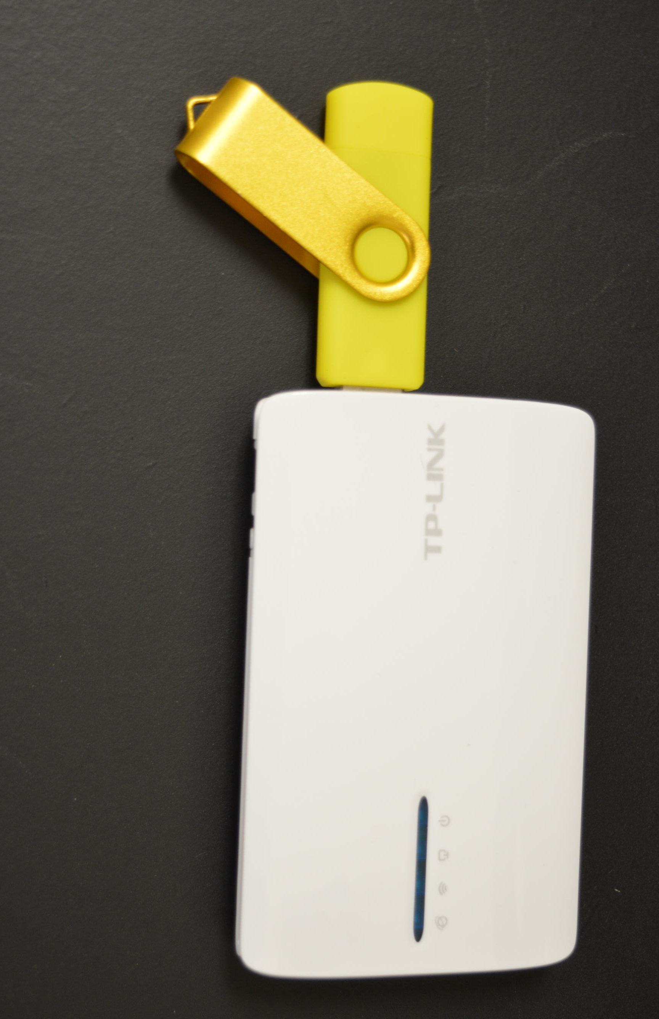
TPLINK 3040 ROUTERS /BIBLEBOX
See Biblebox.Org
15 simultaneous connections
Goes 75-100 ft easily
Up to 1 km with an antenna
Can distribute at a meeting
Or even covertly

Slide 14
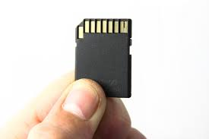
OTHER DISTRIBUTION
SD cards
Internet downloads
Bluetooth
External Hard drives
Internet radio e.g. icecast, 365 etc

Slide 15
