Slide 1
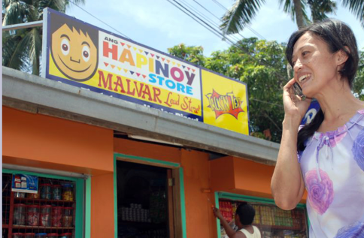
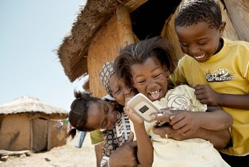
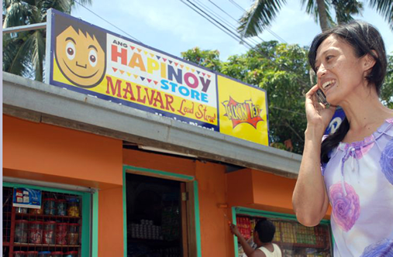
The Next Billion
And how to share Christ with them....

Slide 2
In Three Parts…
The Technology That Will Reach The Next Billion
Understanding The Next Billion
Our Internet Ministry Response To The Next Billion

Slide 3
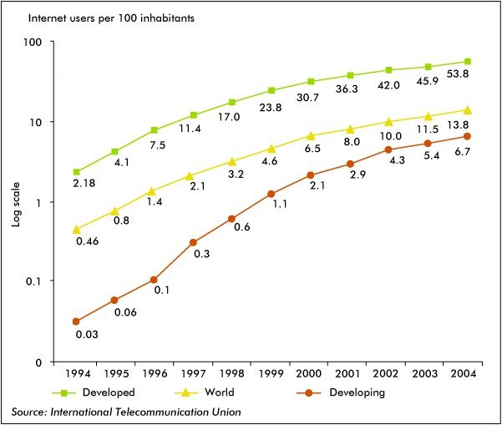
The Traditional Internet Has Peaked
The traditional Internet = desktop PC + landline (or cable) in a home or workplace
The number of traditional Internet subscribers is now very close to the number of landlines
Landline growth has stalled

Slide 4
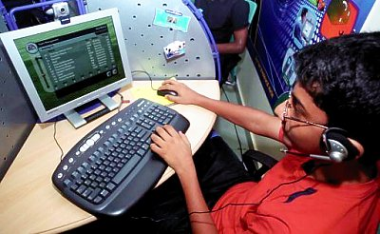
Growing The Edges…
Now the logistical task is to get Internet access to people who do not have landline or cable and who may be earning $500 a month or less
The spiritual task is to share the gospel with these new users ‘on the edge of cyberspace’.
Many of these are in developing nations such as China, India and the Middle East –where gospel proclamation is most needed
The ‘next billion (s)’ will come online in the next two to three years and the Internet will DOUBLE in size!!!

Slide 5

Things May Be Different….
The next billion Internet users will not be Westerners
The next billion Internet users will not have computers connected to landlines
They will not speak English as their first language
Most of them will not come from Christian religious backgrounds
The God they seek may be very different from what we expect…
But first lets look at the technology they will be using…..

Slide 6
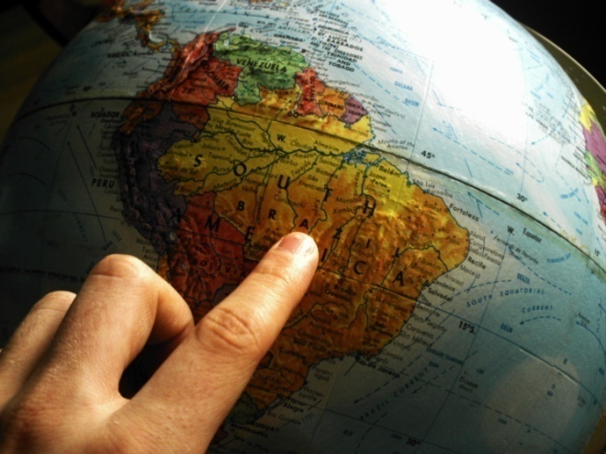
Stages of the Internet
Pre-1993 – Bulletin boards, email
1994-1997 Early HTML
1997-2002 HTML plus widgets
2002 - 2005 Web 2.0
2005 – 2007 Death of Web 2.0, emergence of the media driven web
2007 -2014 - The mobile Internet & the developing world Internet

Slide 7
Mobile Statistics http://mobithinking.com/mobile-marketing-tools/latest-mobile-stats
Over 5.3 billion mobile phone accounts
Over 1 Billion smartphone accounts (18%)
76% of the global population have mobile phones
68% of even developing nations population
6.1 TRILLION text messages sent in 2010
Many mobile Web users are mobile-only, i.e. they do not, or very rarely use a desktop, laptop or tablet to access the Web. In Egypt and India this is 70 percent and 59 percent of mobile Web users are mobile-only. Even in the US it’s 25 percent.
By 2011, over 85 percent of new handsets will be able to access the mobile Web. Please note that this does not mean smartphones – you do not need a smartphone to access the mobile Web (but it does make for a richer experience).

Slide 8
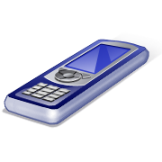
Starting In Mobile Platform Ev.
http://ied.gospelcom.net/mobile-outreach.php - the mobile evangelism page on the Internet Evangelism Day website
http://mobilev.pbwiki.com/FrontPage
MobileEV - a mobile evangelism wiki
http://mobileministrymagazine.com/
Mobile Ministry Magazine

Slide 9
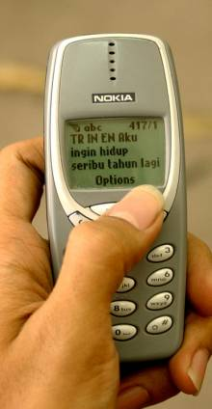
SMS
In the Muslim world SMS messages are the PREFERRED method of responding to the gospel
Text 2 Email gateways are now becoming a critical part of evangelism!
Soon crusades will have a number you can text to indicate a decision to follow Jesus.
A URL for follow-up can be sent by return SMS http://en.wikipedia.org/wiki/SMS_gateways

Slide 10

Podcasts & Audio Blogging
http://ied.gospelcom.net/podcasting.php - outreach potential of podcasting
www.itunes.com/podcasts/ - iTunes podcast directory
http://www.podcastalley.com/ - Podcast Alley - thousands of podcasts...
http://www.christiantuner.com/ - ChristianTuner.com - Christian Internet radio stations
Short audio clips (under ten minutes, preferably under 3 minutes) can be a powerful witness
Audio is personal and persuasive
Audio better than video in low bandwidth areas.
Can be streamed as Internet radio
Testimonies, gospel presentations, music, prayers etc.

Slide 11
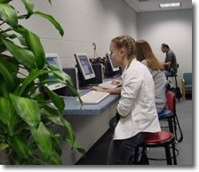
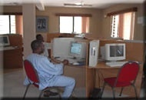
Internet Cafes
Internet cafes can be found in most cities in the developing world
They are and will continue to be a main source of the Internet for many
They often have restricted bandwidth
How can we reach their users for Jesus?

Slide 12
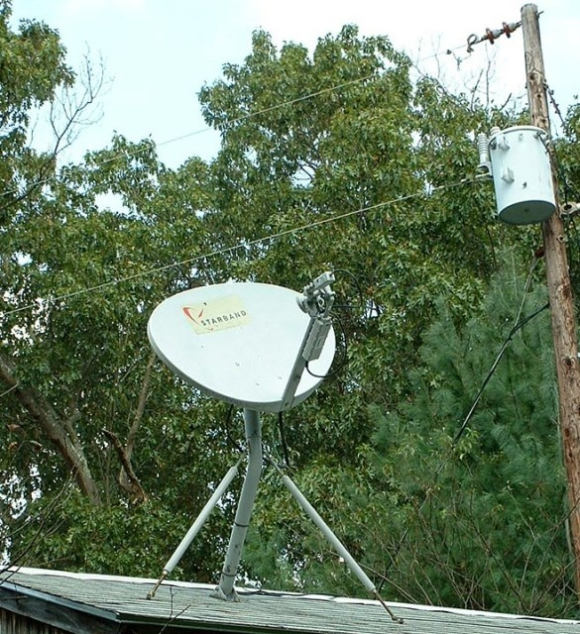
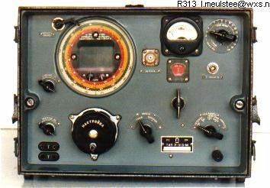
X-Treme Locations
VHF store and forward (single-side band COBAN radios)
Stored Internet (on a local area network) plus email, as hard-drives have 2TB+ storage capacity this becomes quite feasible
Satellite and microwave links
Technological advances are allowing detection of weaker signals and increased range

Slide 13
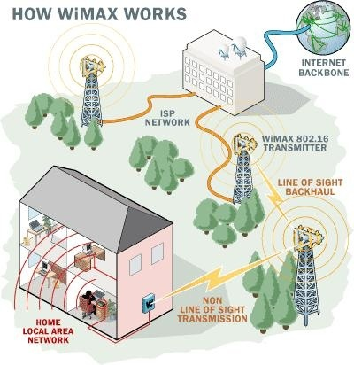
WiMax
WiMax is:
Worldwide Interoperability for Microwave Access
Crudely put it is a long-range version of WiFi
It can use both licensed and unlicensed spectrum
WiMax towers are becoming popular in developing nations

Slide 14

Meraki (Long Range Wi-FI) Routers
Meraki routers are powerful wireless routers that can ‘mesh’ together to cover a large area.
One access point, plus a bunch of Meraki routers can blanket a whole village with WiFI
The routers cover 100-250 meter radius each (compared to 10-30 meters for a normal router)
They are weatherproof

Slide 15

Audio Constraints - Mobile
For voice e.g. bible teaching you can go as low as 8kbps but this is marginal, a good setting is 11,025 Hz, mono, & 16 or 32 kbps
MP3 format is supported by most mobile devices
Audacity is a good free audio editor, you will also need to install the LAME codec for MP3 file output.
Format Factory will convert files among various mobile audio formats.

Slide 16

Mobile Video Constraints
Video accounts for 69% of mobile data traffic
Small screens on most phones - therefore should not have “busy” or crowded screens
Head and shoulders shots are good
Remember network speed and keep within the bounds of your viewers
Shorter is generally better
Stories, quirky, humorous, human interest…
PowerPoint To Video works well in many cases
Share via Bluetooth

Slide 17
Format Conversion
Format Factory (convert audio & video to various mobile formats)
FFCoder (for the heavy lifting, tweaking and converting audio & video)
SUPER audio and video converter (MajorGeeks pick)
NEXT Video Converter
MobiPocket Creator (mobile ebooks etc)
Calibre Ebook Creator (frequently updated so v. good)
Audacity – high quality, free audio editing and file conversion software
Ispring converter (PPT to Flash)
OpenOffice.Org (PPT to Flash can be done w/in OO)
Leawo.com – professional quality, converts PPT to many video formats

Slide 18
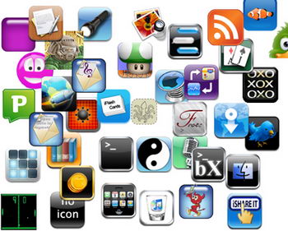

Mobile Apps
Great variety in usage, much higher in Japan than in USA
Native apps (on your phone)
Internet apps (online apps)
Internet apps still dominate
Android platform is catching up fast
Flash & HTML5 may change the field
Free & fast app development
Long tail : specific apps work well

Slide 19
App development
SwebApps
http://www.redfoundry.com/
BuzzTouch – free mobile app builder for iphone & Android
http://en.wikipedia.org/wiki/Mobile_application_development
Building Android apps
Android developers guide
W3schools
How to create an iPhone web app
http://en.wikipedia.org/wiki/List_of_digital_distribution_platforms_for_mobile_devices
http://en.wikipedia.org/wiki/Mobile_app

Slide 20

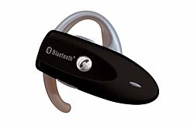
Bluetooth uses the 2.4 GHZ spectrum
The technology is useful when transferring information between two or more devices that are near each other in low-bandwidth situations.
Just starting to take off in Asia
Common in Middle East & Europe
Has serious security & interference issues
Proximity Marketing: have people w. Bluetooth find your content / product
Bluetooth Blaster – serves content by Bluetooth and is mobile, supports 21 simul. connections.

Slide 21
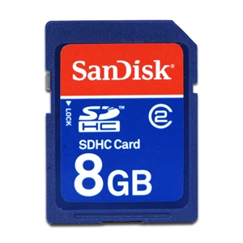
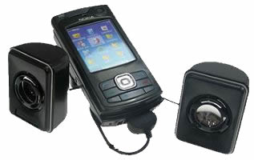
The Mobile Bible College
Curriculum on an SDHC card
A mobile phone + speakers
Does not need reliable electricity
Does not require Internet access
Portable, secure and looks normal
Can train up to 25 people
Useful for house churches
Works with most types of phones
SDHC cards: 8Gb will hold up to 500+ hours of reasonable quality audio
30 hrs lecturing = one bible college subject (with some class discussion of the material)
So therefore 500 hrs = 16 subjects = 4 semesters of 4 subjects = 2 year course on a fingernail-sized chip

Slide 22
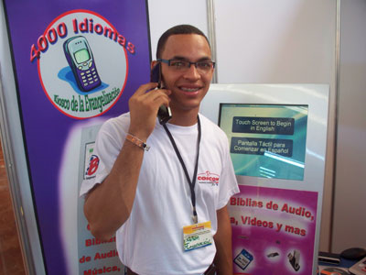
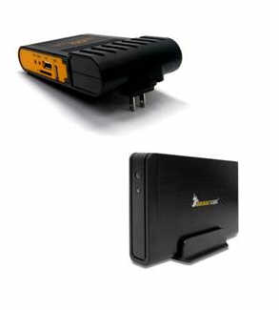
Mobile Evangelism Kiosks
Model A) Physical kiosk with SD card duplication capabilities
Model B) A 2TB HDD loaded with content plus a PlugPC and wireless router so gospel can be downloaded directly to phones. Highly mobile, does not require an Internet connection, can even be used on buses etc.
Audio bibles in numerous languages as well as key teaching materials - http://www.kioskevangelism.com/
Being developed by Stephen Keel in Virginia with assistance from Lightsys, MAF-LT, ICCM, GRN, and Cybermissions

Slide 23


Orality
Use mobile phones to reach oral learners – up to 70% of the population are primarly oral learners
Put audio bibles on SDHC cards or on .mobi websites
Listen to the bible stories in a group (using a mobile phone w. speakers etc.) and discuss.
Use with Way of Righteousness and other oral storying materials being developed

Slide 24

Creating Contextualized Content
Collect indigenous Christian music, sermons, teaching and stories using mobile phone video and audio recording and note-taking capabilities
Upload to a website or online repository, add metadata then make searchable
Duplicate collections (say in a particular language) e.g. on SD cards
Share via Bluetooth

Slide 25

Say Goodbye To Privacy…..
The Internet is being watched….
Keystroke loggers
Splitting of fibre-optic cables
Download monitoring
Rapid ‘reading’ and storing of website content by computers
Any mention of politics or local organizing will get you instantly banned in over a dozen countries
Wisdom is essential

Slide 26
Part 2:
Understanding The Next Billion

Slide 27
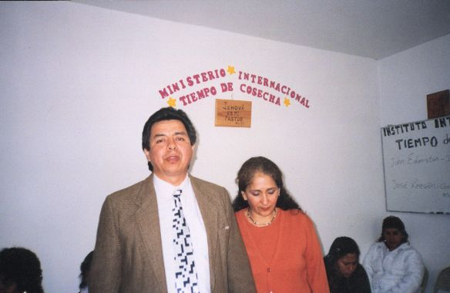
The Global Middle Class
Average income will be $2000 - $5000 a year
Many will live in urban slums – even teachers and professors
They will want HOPE
They will want practical information as well as entertainment
About 20 major languages will cover 95% of them….

Slide 28

The Next Billion - Demography
They have cell phones and TVs but not cars or computers or telephone lines
The Internet will be on a cell phone or icafe
They will probably want an SMS response
They will be highly family centered and 80% will be under 30
Many will NOT be very postmodern
Many will be single

Slide 29
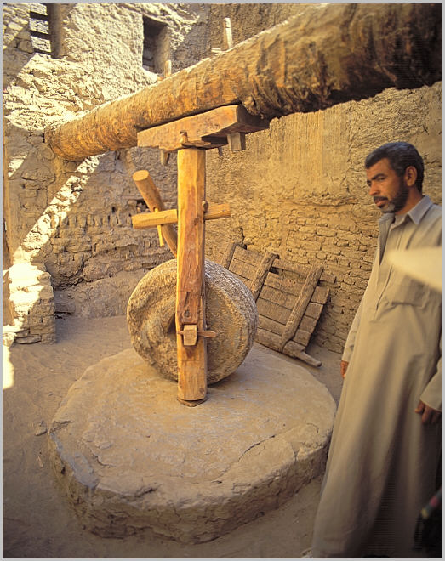
The Next Billion - Aspirational
They will be highly aspirational & tech hungry
Want employment and business opportunities (business as mission)
Online business plans and online business mentoring as ministry?
Online Christian franchises and micro-franchises and micro-finance?

Slide 30
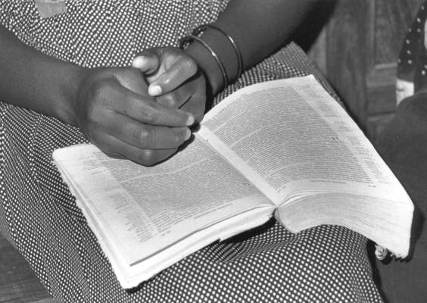
The Next Billion - Holistic
Holistic approach to life and ministry
Want to know ‘how to’ do a wide range of community development tasks as part of ministry
HIV / AIDS Education
Water purification
Simple church construction
How to set up a Christian pre-school

Slide 31

The Next Billion - Independent
Proud of their own culture and own way of doing things
Will not appreciate our denominations, “Christian culture” or national politics
Want equal partnership (not Western ownership)
Want to make the on-the-ground decisions
Have alternative church structures

Slide 32
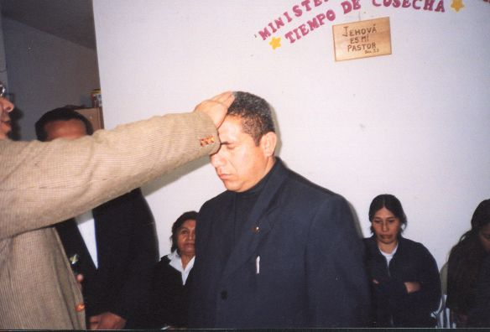
The Next Billion - Ministry
House church movements
Will often be Pentecostal Christians
Seekers from animistic backgrounds who need deliverance
Extended families
Shame based cultures
Converts from Islam, Hinduism and Buddhism
Pastors with little formal training needing mentoring
Prosperity teaching very popular
Questions about corruption, poverty, and injustice: ‘why are we so poor’

Slide 33
Part 3:
Our Response

Slide 34

Technology
Interactive
Participative
Experiential
Non-computer based (cellphones!!)
Non-literate – verbal / audio
Brief & Compressed
Holistic
Tagged / RSS
Multiple languages & cultures
Multiple bandwidth versions

Slide 35

Design
Internationalize
Clarity
Reduce idomatic expressions
Be hopeful and aspirational
Explain, explain, explain….
We will have one billion+ ‘newbies’ online within the next three years!
It will be the total re-birth of the Internet and of web page design
Offer a helpful handshake to the new Netizens…

Slide 36

Attitudes
Scripture rather than culture
Spirit rather than method
Compassion rather than just content
Trustful connection rather than just ‘customer service’
‘Come into our community’ rather than just ‘pray the prayer and go away please’
Engaged with the whole of life rather than cerebral, engaged with a ‘bunch of concepts’

Slide 37

Love Newbies
If the user is made to feel dumb they just go away
If their problems are ignored they will resent you
But if people feel they are helped quickly they will become loyal
If the user feels empowered they build enthusiasm
If a user feels ‘’hey I am cool I can do this’ they build pride and tell others

Slide 38
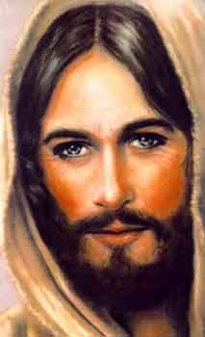
WWJD
What would Jesus do?
Sure these changes are hard but how many people will they help us reach?
But I like the Internet the way it is!!
Why can’t they just be like us?
This is way too complicated?
Get help
Build teams
Let God guide you

Slide 39
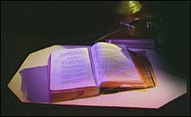
Local Networks
Develop in-country networks
Cultivate local leaders
Pay for translation, use locals, use the translation process to build relationships
Give people an aspirational career pathway within your ministry
Volunteer – Senior Volunteer – Part-Time Paid – Full-Time Paid
Delegate real authority and the right to contextualize your ministry

Slide 40

Be First To Market
Be first to ‘market’ – be one of the first in a particular language group
This gives you great prestige and influence
It also introduces you to early adopters and to leaders in that culture
Partner with missions agencies and churches overseas

Slide 41

Calling Home….
There are huge international connections between migrants working overseas and their home communities
They ‘call home’ for news and in return can share the gospel
The next billion Internet users will have friends and relatives in America
We can recruit these people as volunteers
Ethne To Ethne – those people with the gospel reaching those without the gospel - via the Internet

Slide 42
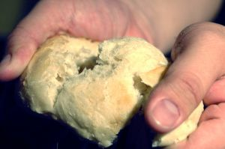
Partnering
Sharing translation resources
Sharing follow-up systems
Sharing strategic information on people groups
Sharing good podcasts and other content
Partnering for on-the-ground church planting and holistic ministry efforts resulting from cyber-ministry

Slide 43
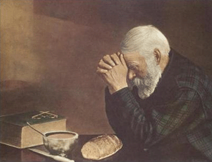
Prayer
The next billion will be a spiritual warfare context
Ministering to animists, Hindus, Mulsims and Buddhists will require much prayer and intercession
Your computer will break down if you don’t pray!
You will break down if you don’t pray!

Slide 44
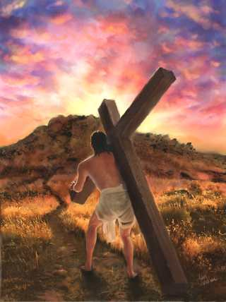
Conclusion
The Internet will double in the next three years as cellphones become Internet capable
The next billion users will be ‘newbies’ from the developing world
These are people for whom Christ died and that missionaries long to reach
If you get on board early you can be part of completing the Great Commission

Slide 45

About Cybermissions
www.globalchristians.org
www.cybermissions.org
John Edmiston (CEO)
Based in Carson CA
Focused on delivering online training in developing world contexts.
johned@aibi.ph
+1-310-549-6791

